Slide 1
Stage to Stop Mapping

Slide 2
Hierarchical Algorithm
If time stamps at a stage are uniformly distributed, assign tickets based on the length between stops
If time stamps are not uniformly distributed, try Mean Shift Clustering, breakpoint/changepoint method
If the number of groups obtained in both Mean Shift Clustering and breakpoint/changepoint method match the number of stops corresponding to the stage, stage to stop mapping is possible at that stage
Additional method to assign tickets to stops is based on the Productions/Attractions of each stop

Slide 3
Mean Shift Clustering
Number of clusters are not defined apriori
Determining bandwidth is the challenge involved
Hyperparameter for determining bandwidth is quantile
For instance, quantile = 0.5 means that the bandwidth used for finding clusters is equal to the median of all pairwise distances
Hyperparameter tuning is necessary to find clusters as many as the stops corresponding to that stage

Slide 4
Changepoint/Breakpoint method
Number of clusters have to be defined apriori
The changepoints can be determined based on the sudden change in mean or sudden change in variance
Hyperparameter tuning is not necessary
The function will return the clusters automatically

Slide 5
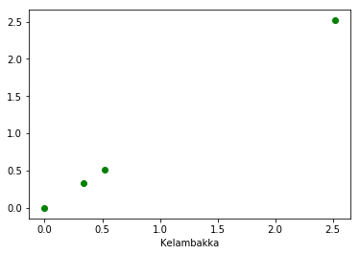
Cluster 0: [0, 0.33, 0.51], Cluster 1: [2.51]

Slide 6
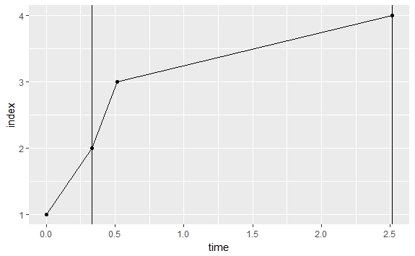
Cluster 0: [0], Cluster 1: [0.33, 0.51, 2.51]

Slide 7
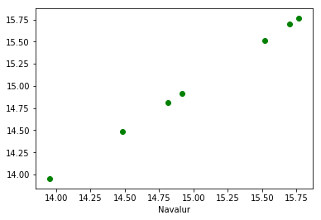
Cluster 0: [13.95], Cluster 1: [14.483, 14.816, 14.916], Cluster 2: [15.51, 15.7, 15.76]

Slide 8
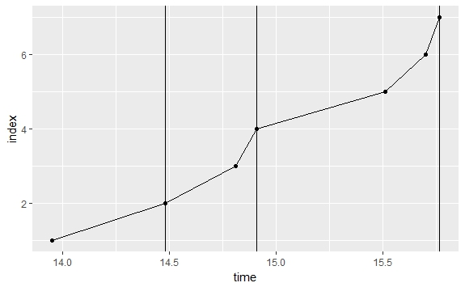
Cluster 0: [13.95], Cluster 1: [14.483, 14.816, 14.916], Cluster 2: [15.51, 15.7, 15.76]

